Slide 1
Identifying regions of faces
By Aaron, Gytis, Seamus and James

Slide 2
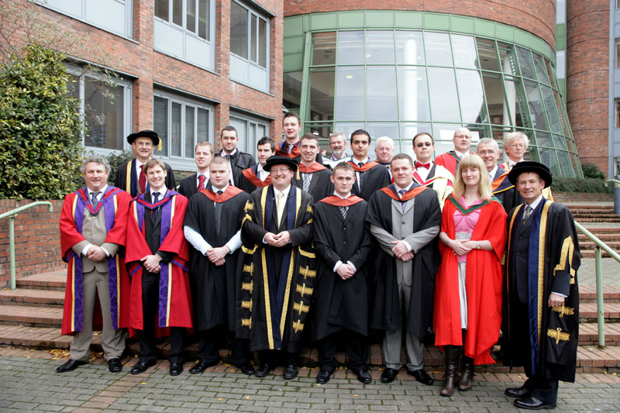
Our Project
To detect the regions of faces in this image

Slide 3
Research
HOG – Histogram of oriented gradients
Haar-Cascades Algorithm for face detection
Viola-Jones (Haar-Cascades)

Slide 4
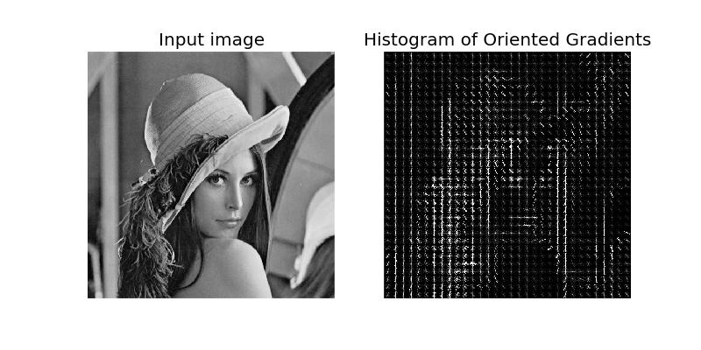
HOG
Needed to be pre-compiled
Only worked on an out-dated version of Visual Studio
Too complex for the task at hand
Would not work on Python 2.7 or Open CV versions later than 3
(Sharky93.github.io, 2017)

Slide 5
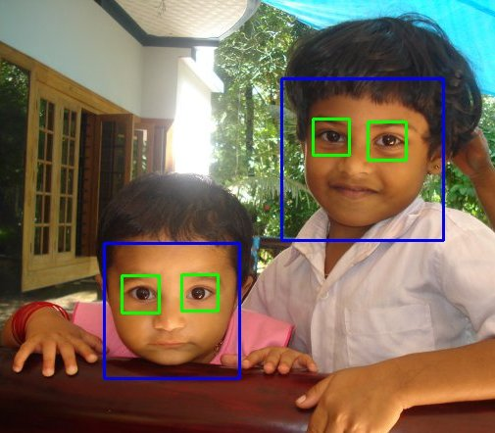
Haar-cascades
Readily available
Low percentage of error
Machine Learning algorithm
Part of OpenCV
(Docs.opencv.org, 2017)

Slide 6
Implementation
In Python using OpenCV
Convert to Greyscale
Enlarge image to help cascade
Cascade for faces
10% skin check
Draw boxes around regions
Reduce to original size
Show image

Slide 7
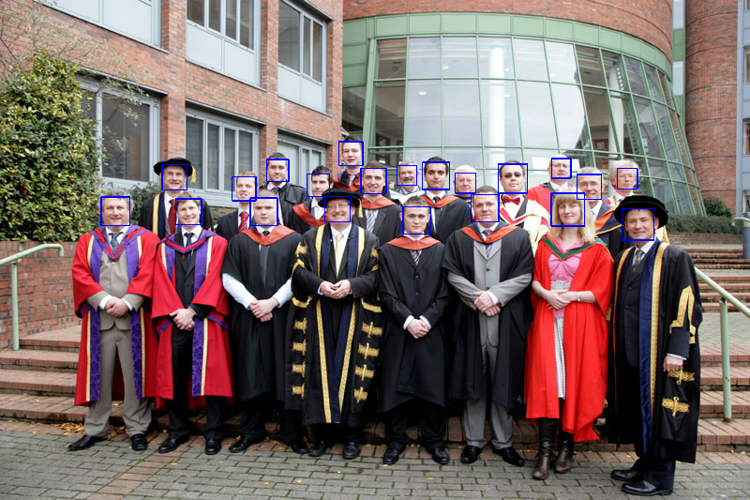

Slide 8

Results
Tested on Different Images
Reduced amount of false positives

Slide 9
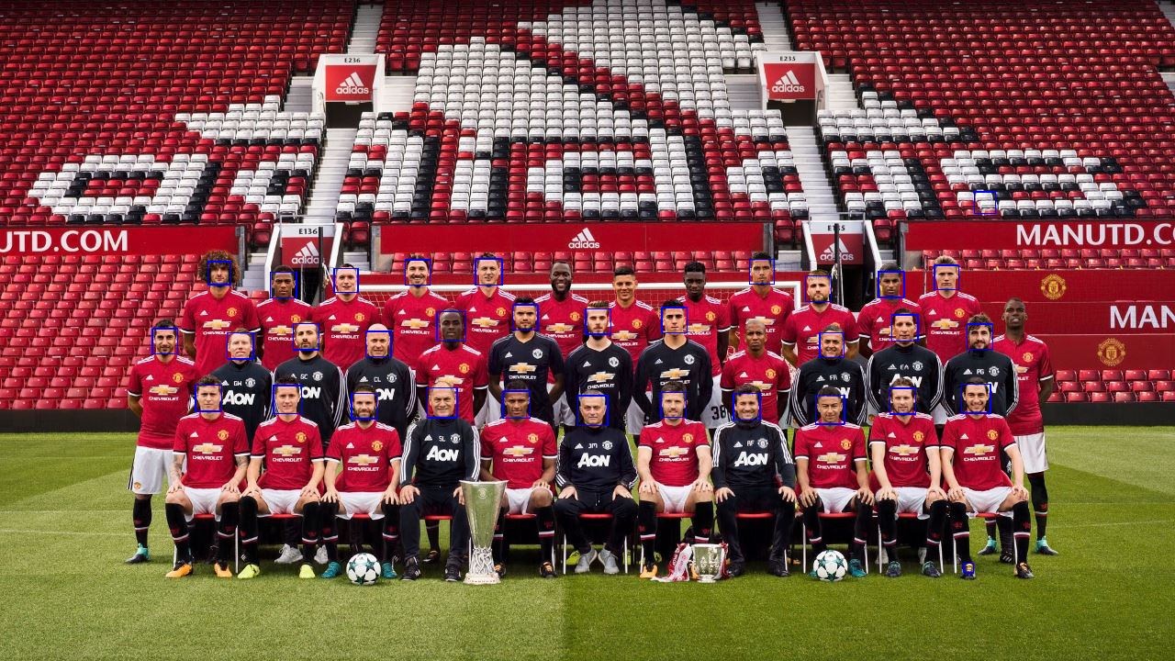
Results
Skin Detection

Slide 10
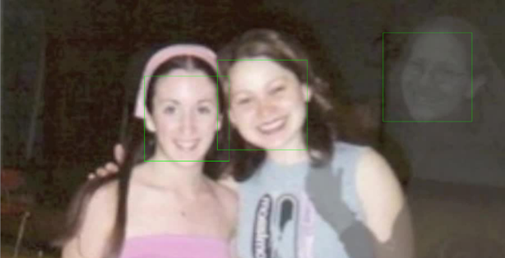
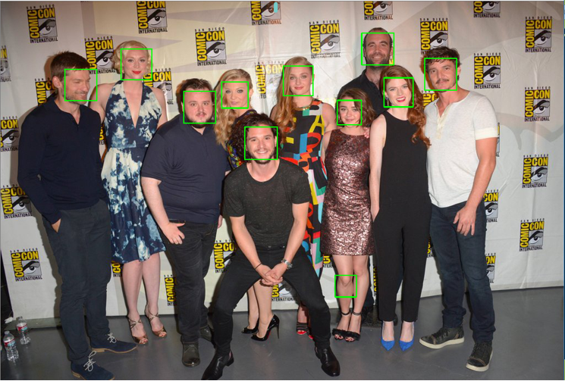

Reflection and Analysis
Team worked well
Algorithm is solid, fails at points
Task completed adequately
Would like to expand to facial recognition

Slide 11
Thank you
References:
Docs.opencv.org. (2017). OpenCV: Face Detection using Haar Cascades. [online] Available at: https://docs.opencv.org/3.3.0/d7/d8b/tutorial_py_face_detection.html [Accessed 24 Nov. 2017].
Sharky93.github.io. (2017). Histogram of Oriented Gradients — skimage v0.11dev docs. [online] Available at: http://sharky93.github.io/docs/gallery/auto_examples/plot_hog.html [Accessed 24 Nov. 2017].

